Slide 1

G2M insight for Cab Investment firm
Mark Kimutai Kitur
08/05/2024
LISUM33

Slide 2

Introduction
XYZ is a private firm in US. Due to remarkable growth in the Cab Industry in last few years and multiple key players in the market, it is planning for an investment in Cab industry and as per their Go-to-Market(G2M) strategy they want to understand the market before taking final decision.

Slide 3
Total number of observations | 19
Total number of features | 3
Base format of the file | .csv
Size of the file | 1 KB

Slide 4
This graph shows population of cities
From the graph we can conclude that New York city has the highest population. This means NY has the largest possible market.
NY also requires a lot of service providing facilities due to its large scale.

Slide 5
Relationship between users and cities
From the graph we can conclude that New York, San Francisco and Washington DC have the most users.
These cities require more facilities to counter large number of users.
Cities like Phoenix AZ, Tucson, Nashville and Pittsburgh PA have the lowest number of users hence there should huge advertisements implemented.

Slide 6
Total number of observation | 2040
Total number of features | 4
Base format of the file | .csv
Size of the data | 1200KB

Slide 7
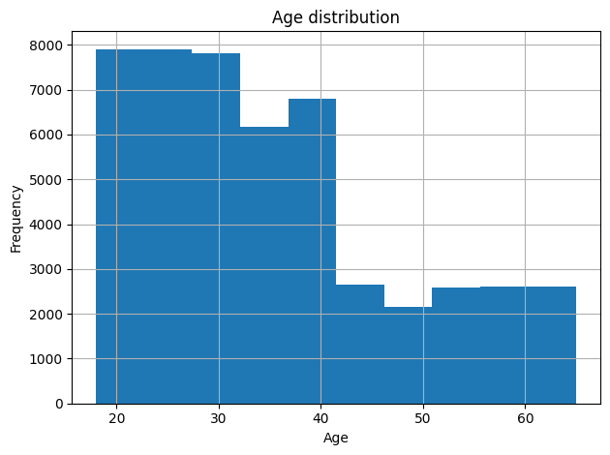
Age distribution
Most users are age between 20-42 with less being the aged.
Aged people are not interested with our goods!

Slide 8
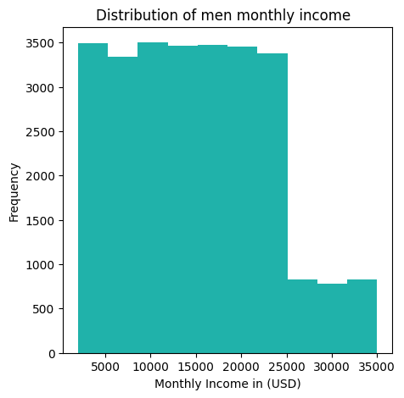
Men’s monthly income
Most men earn income below $25000.

Slide 9
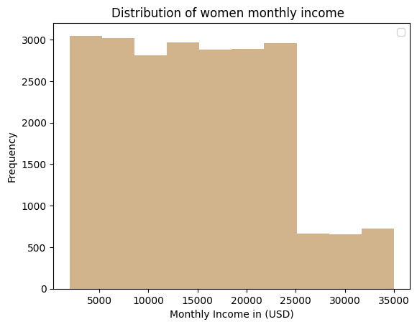
Women monthly income
There is less difference compared to men’s income.
Although, men tend to earn more.

Slide 10
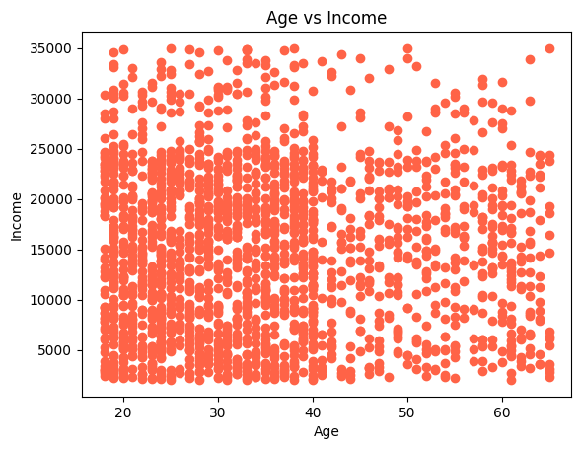
People below 40 years earn less income
Less expensive products should be manufactured to improve stocking.

Slide 11
Total number of observation | 440098
Total number of features | 3
Base format of the file | .csv
Size of the data | 8788 KB

Slide 12
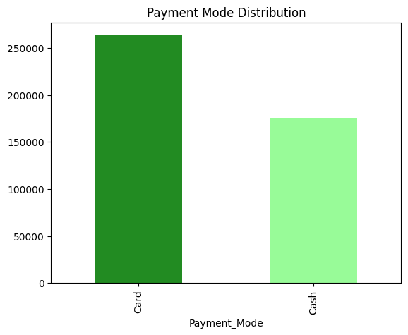
Preferred Payment mode

Slide 13
Total number of observation | 20000
Total number of features | 8
Base format of the file | .csv
Size of the data | 20663 KB

Slide 14
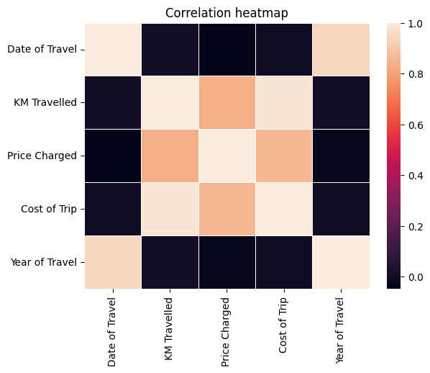
Correlations
1 (brightest) means high correlation whole 0 (darkest) means low correlation.

Slide 15
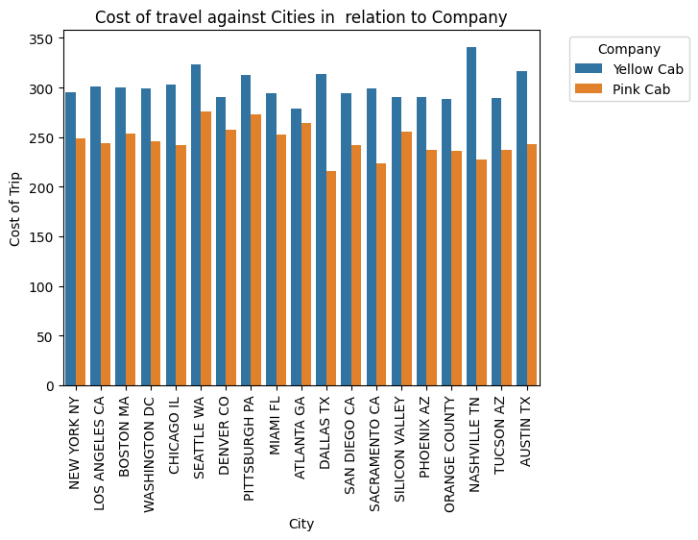
Cost of travel
Pink cab is almost even.

Slide 16
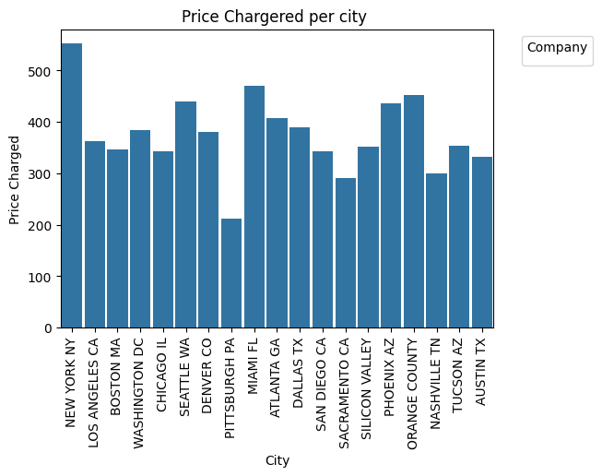
Price per city
New York looks expensive while Pittisburgh PA seems very cheap compared to the rest.

Slide 17
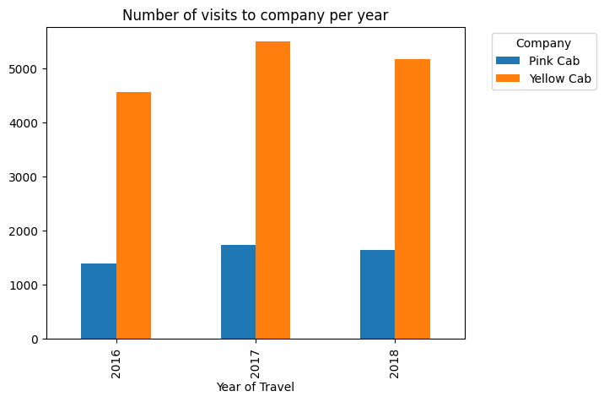
Number of visits per year
Fairly stable although it’s very low for company Pink

Slide 18
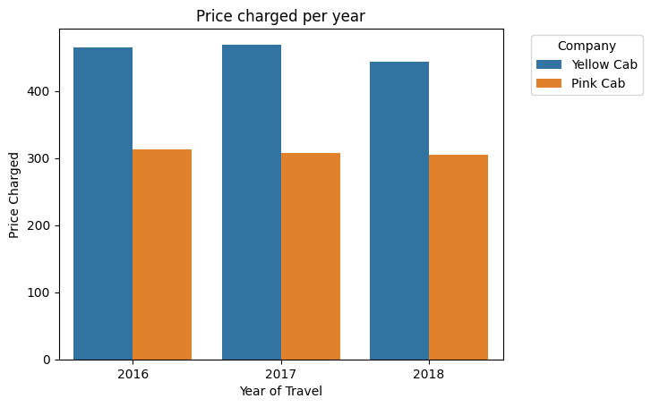
Price charged per year
It’s really stable but low for Yellow Cab.
That’s why they have highest number of visits per year.

Slide 19
Recommendations
Customers mostly prefer cashless transactions.
Lowering the price attracts more customers.
Cities like Phoenix AZ, Tucson, Nashville and Pittsburgh PA have the lowest number of users hence there should huge advertisements implemented.
Less expensive products should be manufactured to improve stocking.
There should be more sensitization among the aged and products to be designed in a way that suits them.

